Slide 1
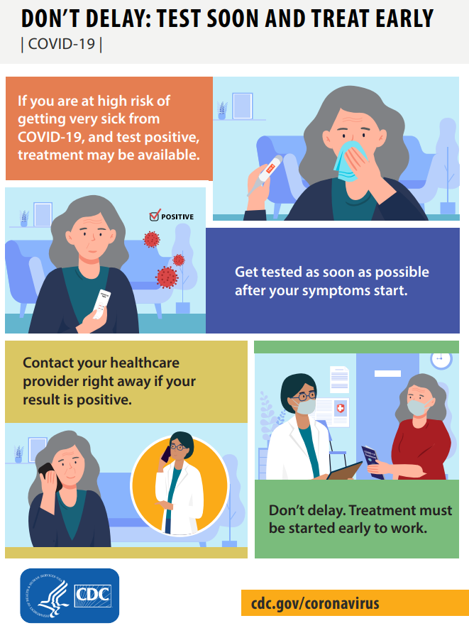
Remdesivir (Veklury™)
What is remdesivir?
Remdesivir is a prescription medicine used for the treatment of COVID-19 in adults and children 28 days of age and older and weighing at least 7 pounds (3 kg).
Who can receive remdesivir?
Who | When | How
Non-hospitalized patients with mild or moderate COVID-19 who are at high risk of getting very sick from COVID-19 | As soon as possible and up to 7 days after symptoms first appear | Through the vein (IV) one time each day for 3 days in a row.
Patients who are hospitalized due to COVID-19 | Upon admission to hospital | Through the vein (IV) one time each day for 5 days in a row (can be up to 10 days)
What are possible side effects of remdesivir?
Most common side effects with remdesivir are nausea and liver inflammation. Allergic reactions are possible but rare. Speak to your healthcare provider if you have questions.
For more information
https://www.cdc.gov/coronavirus/2019-ncov/your-health/treatments-for-severe-illness.html -
https://www.cdc.gov/coronavirus/2019-ncov/need-extra-precautions/people-with-medical-conditions.html -

