Slide 1
Introduction to AUC-based Pharmacokinetic Vancomycin Calculator
USER GUIDE

Slide 2
Multiple Versions
Macro-Enabled
This is full version
Click button navigation
End-user customization
May present security issues at certain institutions
Macro-Free
Reduced version
No security risk, but less user friendly

Slide 3
Macro-Enabled
USER GUIDE

Slide 4
Enable Macros
First Time users will get this alert, click “enable content” to proceed

Slide 5
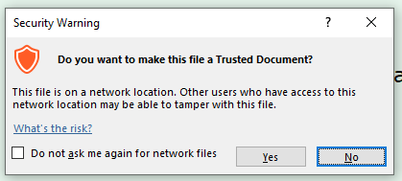
Enable Macros
Prevents re-warning

Slide 6
Onscreen Navigation
Click on screen to navigate to calculators

Slide 7
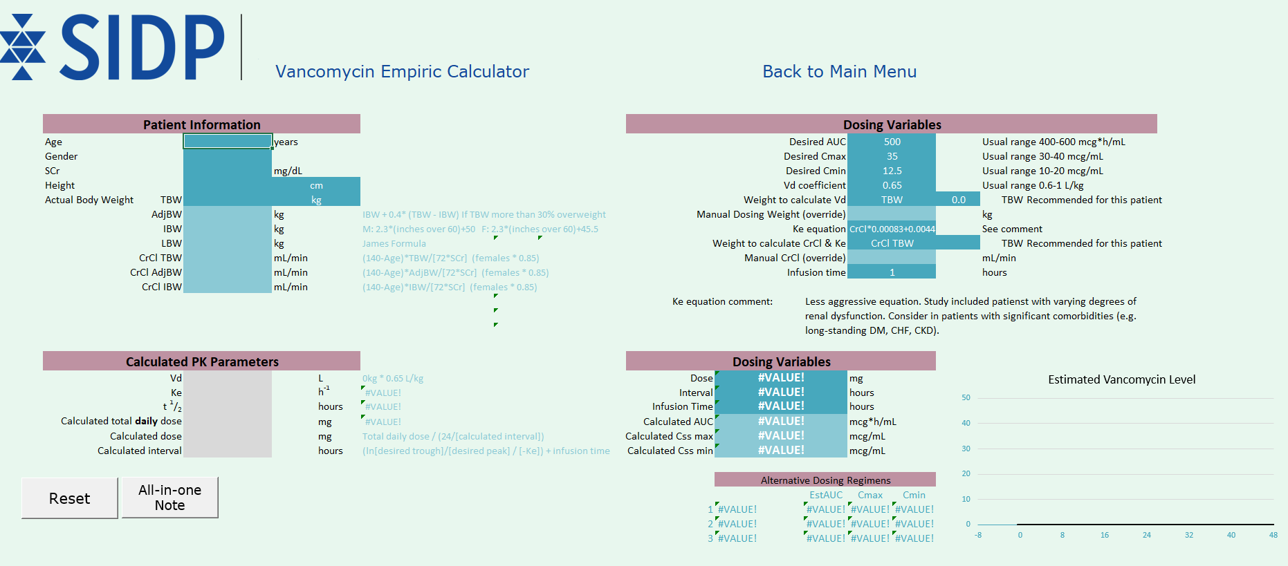
Enter Data
Mandatory fields are darker color
Navigate to
main menu
Reset all data fields

Slide 8
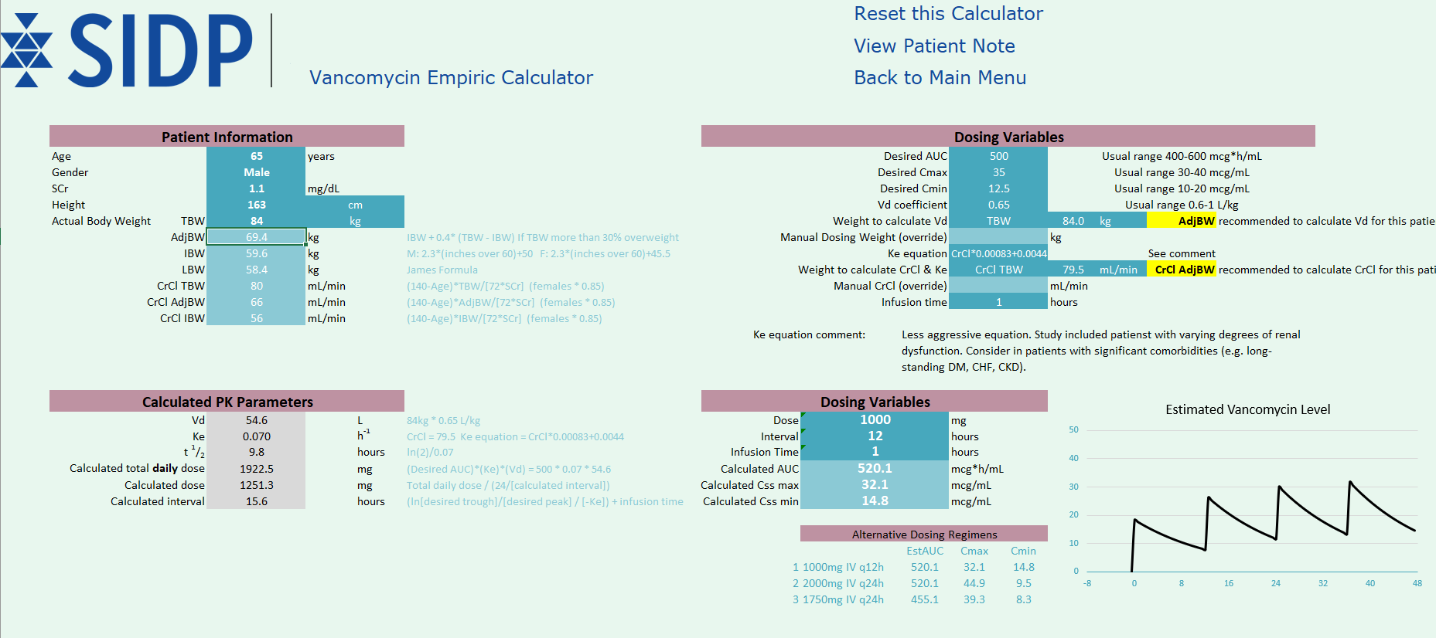
Enter Data
Full customization of targets for each patient, but defaulted to save time
Highlight alerts inform users that dosing weight may not match recommended weight
Detailed calculated PK parameters
A ‘best dose’ is defaulted, but alternatives are given as ‘top 3’

Slide 9
Complete Workup
Once complete, a note is available for users

Slide 10
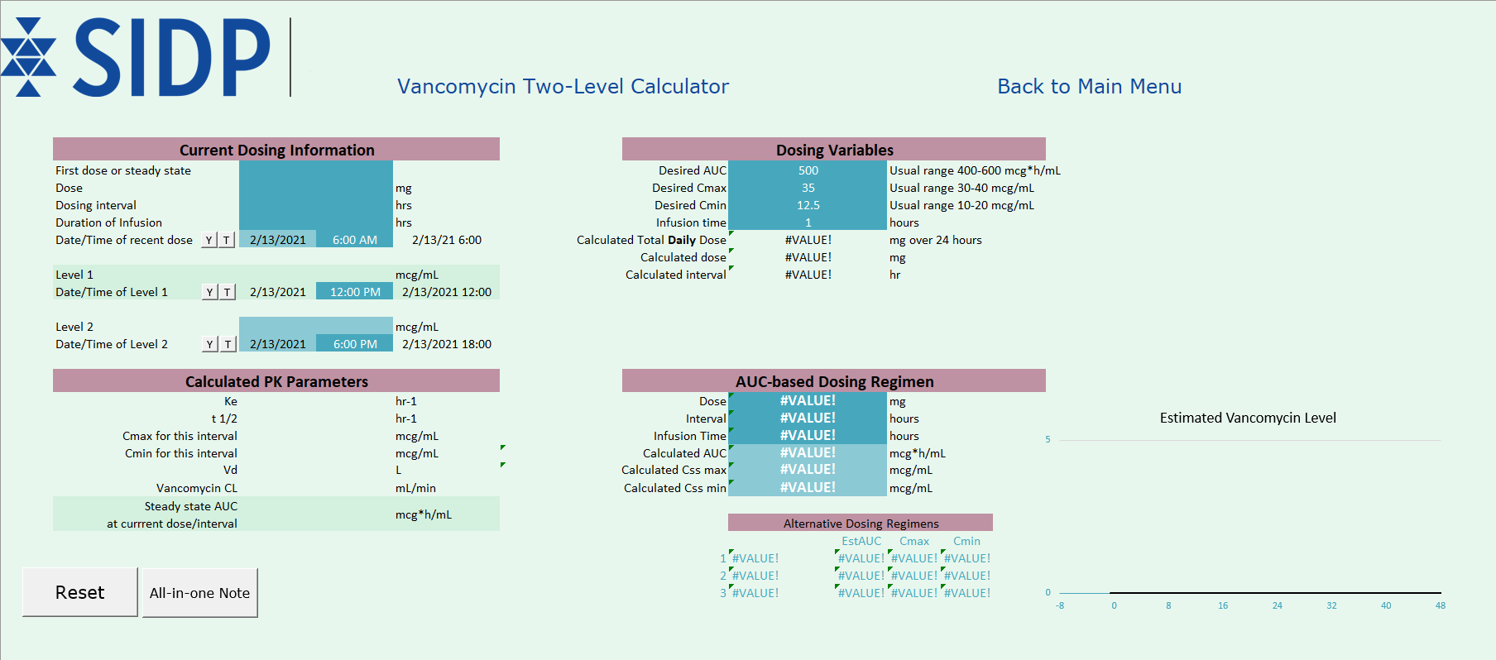
Two Level Calculator
Dates and Times must be entered in military/hospital time and using a colon (i.e., 16:54) – Be exact!

Slide 11
Two Level Calculator
Toggle buttons for Y and T are for yesterday and today

Slide 12
Macro-Free
USER GUIDE

Slide 13
Onscreen Navigation
Navigation is now done by clicking tabs
These don’t do anything now!!

Slide 14
Warning for Macro-Free
Without the “reset”, it would be easy to get data from different patients “cross-contaminated”, it would be best to re-open between patients!!!!

Slide 15
Introduction to AUC-based Pharmacokinetic Vancomycin Calculator
SUPER USER GUIDE

Slide 16
Full Customization
Click here to customize values for your site

Slide 17
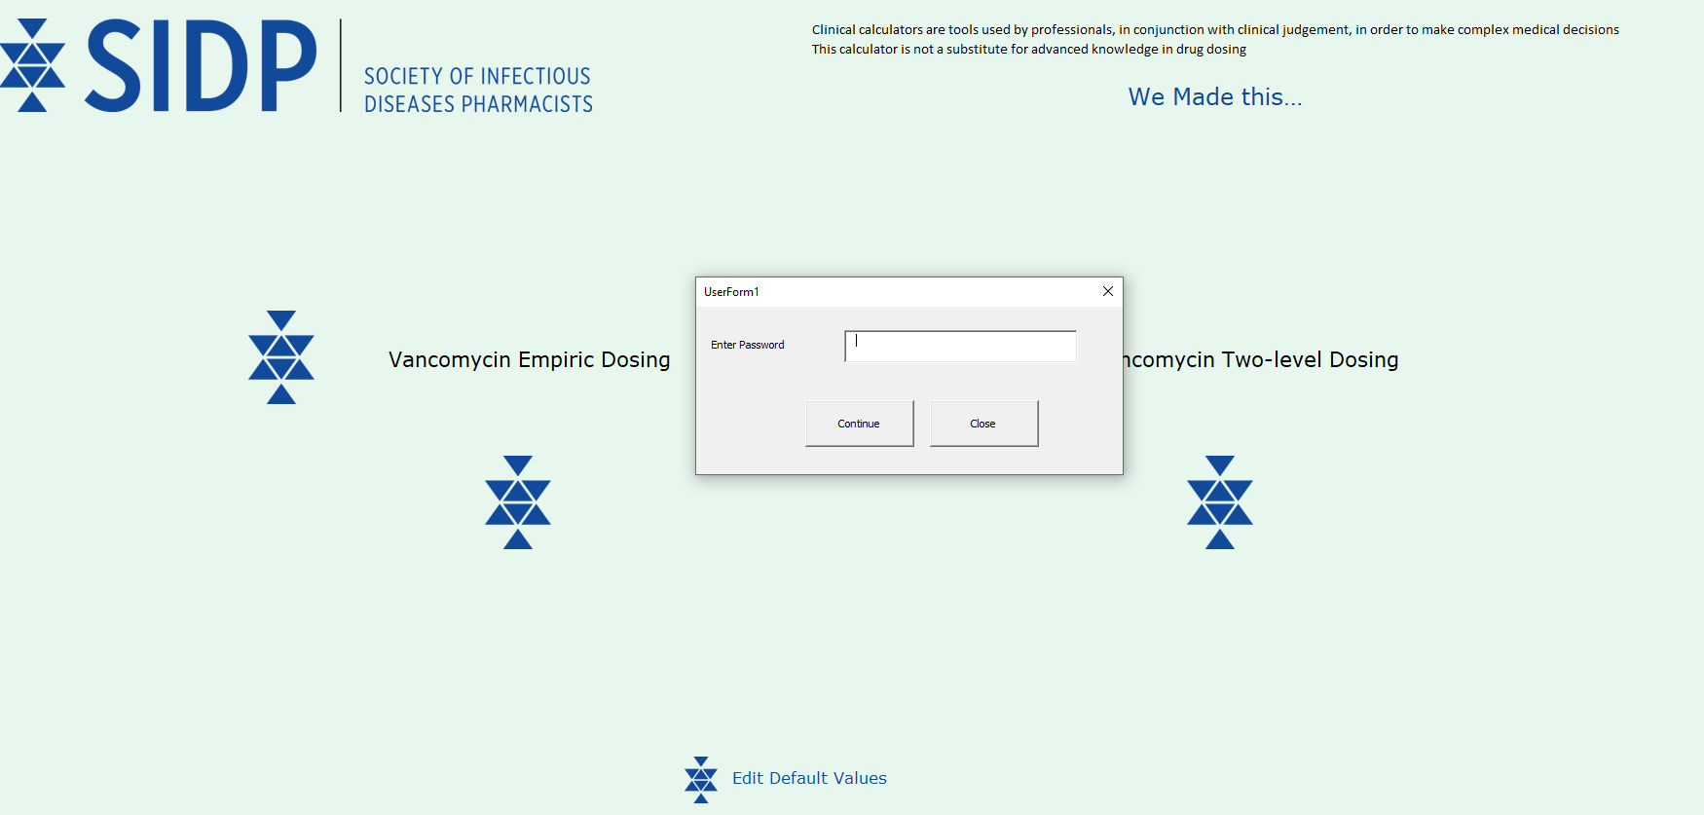
Default Password is SIDP (Case Sensitive)

Slide 18
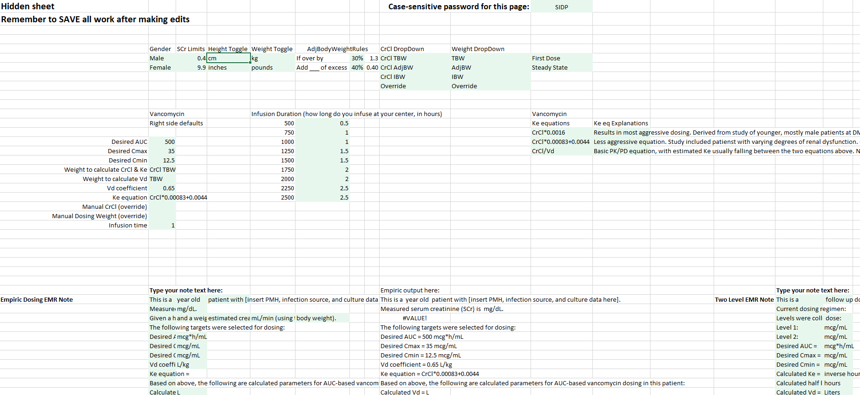
Anything in GREEN Can Be Altered
Page Password
Dosing Defaults
Infusion Times
Note Text
Empiric
Two Level

Slide 19
Whatever You Do Here – SAVE TO YOUR FILES
Click “UPDATE AFTER CHANGES” to force the changes in this worksheet to affect the other worksheets, then save to your computer
This button is powered by a Macro, so it will only work in “macro-enabled”
To save “macro-free” with updates, make updates to “Dlsheet”, then select “Main” worksheet, then save to your computer

Slide 20
Introduction to AUC-based Pharmacokinetic Vancomycin Calculator
USER GUIDE

