Slide 1
Vancomycin Therapeutic Drug Monitoring: AUC-Guided Dosing and Monitoring Education for Prescribers

Slide 2
Objectives
Summarize data for trough- and AUC-guided dosing and monitoring of vancomycin
Discuss important operational considerations for AUC-guided dosing of vancomycin

Slide 3
Vancomycin Dosing Guidelines
2009
Goal: AUC ≥400 mcg*h/mL
2020
Goal: AUC 400-600 mcg*h/mL
Due to difficulties performing AUC monitoring, troughs of 15-20 mcg/mL can be used as a surrogate marker for AUC ≥400 mcg*h/mL
Troughs have poor correlation with AUC and are no longer recommended as a surrogate marker for AUC

Slide 4
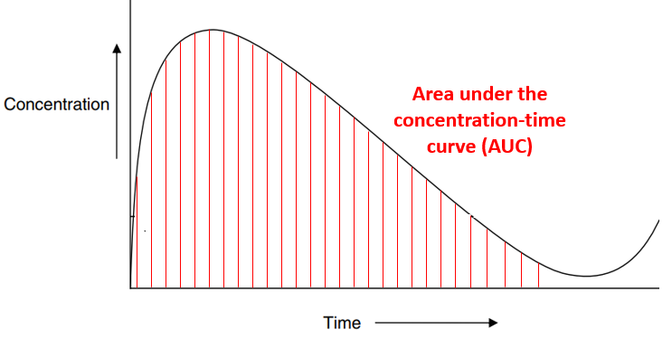
PK/PD Parameters
Notes:
In vitro models and animal studies, and limited human studies have identified AUC/MIC as the preferred pharmacodynamic parameter

Slide 5
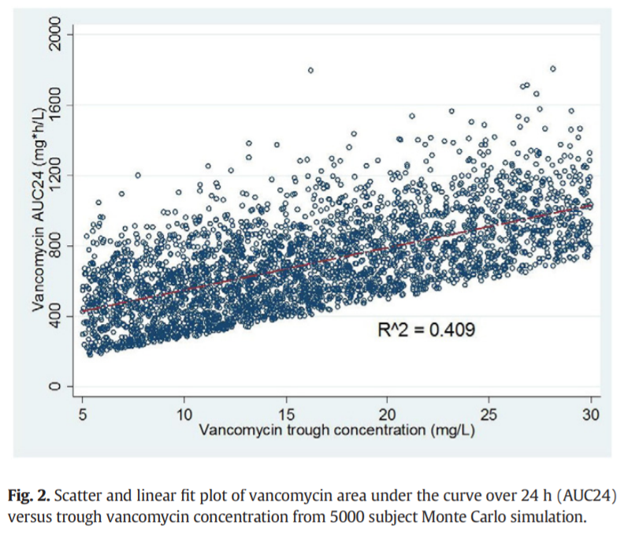
Troughs are a Poor Surrogate for AUC
Pai MP, et al. Adv Drug Deliv Rev 2014;77:50-7

Slide 6
Efficacy Trough ≥15 and AUC ≥400
Meta-analysis of 14 observational cohort studies (n=1,677) evaluating outcomes in patients with S. aureus bacteremia with vancomycin troughs <15 vs ≥15 mcg/mL and AUC <400 vs ≥400
Outcomes | Trough ≥15 mcg/mL OR [95% CI] | AUC ≥400 OR [95% CI]
Treatment failure* | 0.87 [0.60, 1.25] | 0.41 [0.31, 0.53]
30-day all-cause mortality | 1.33 [0.79, 2.24] | 0.47 [0.33, 0.65]
Bacteremia ≥7 days | 0.57 [0.31, 1.06] | 0.53 [0.33, 0.86]
*Composite of 30-day all-cause mortality and persistent bacteremia
Conclusions
Troughs ≥15 mcg/mL were NOT associated with improved outcomes
AUC ≥400 was associated with improved outcomes
Prybylski JP. Pharmacotherapy. 2015 Oct;35(10):889-98.

Slide 7
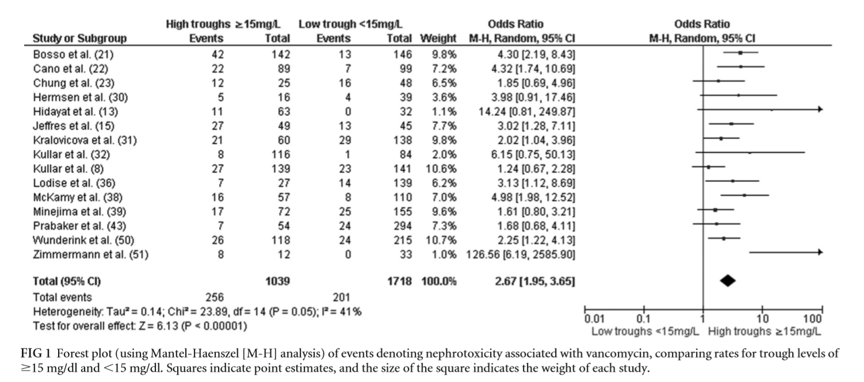
Safety of Troughs >15 mcg/mL
Meta-analysis of 15 studies (n=2,760) assessing the impact of trough concentrations on vancomycin-induced nephrotoxicity
~300% ↑ risk of nephrotoxicity with troughs ≥15 mcg/mL
van Hal SJ, et al. Antimicrob Agents Chemother 2013;57(2):734-44

Slide 8
Nephrotoxicity: AUC-Guided vs Trough-Guided Dosing
Meta-analysis of 2 studies (n=1,443) evaluating the relationship between trough- vs AUC-guided dosing on acute kidney injury (AKI)
32% ↓ risk of AKI with AUC-guided dosing
Aljefri DM. Clin Infect Dis. 2019.

Slide 9
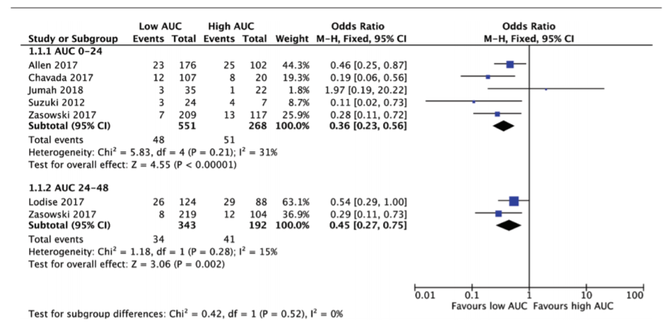
AUC Toxicity Threshold
Meta-analysis of 7 studies (n=1,354) evaluating the relationship between vancomycin AUC and AKI
≤650
>650
55-64% ↓ risk of AKI with AUC ≤ 650
Aljefri DM. Clin Infect Dis. 2019.

Slide 10
Summary
Vancomycin trough concentrations are a poor surrogate for predicting AUC
Vancomycin troughs between 15-20 mcg/mL do not appear to improve outcomes, but have been associated with an increased risk of vancomycin-induced nephrotoxicity
Switching to AUC-guided dosing improves patient safety by lowering the risk of vancomycin-induced nephrotoxicity
2020 ASHP/IDSA/SIDP/PIDS vancomycin dosing and monitoring guidelines recommend AUC-guided dosing with a goal AUC between 400-600 mcg*h/mL
Preferred vancomycin dosing strategy (AUC vs trough) is determined by the patient’s renal function and indication for therapy

Slide 11
Important operational considerations for vancomycin AUC dosing and monitoring

Slide 12
Vancomycin Consults
Vancomycin AUC-guided dosing go-live: insert institution go live date
List institution method of consulting pharmacy
Prescriber alert when ordering vancomycin
Option to consult pharmacy for ANY patients on ANY unit
Screen shot of EHR build for pharmacy consult order at your institution

Slide 13
Vancomycin Consults
Enter the indication (e.g., bacteremia, pneumonia, cellulitis) for vancomycin in the "reason for consult order"
Screen shot of EHR build for pharmacy consult order at your institution

Slide 14
Determining the Dosing Strategy
Screenshot on institutional protocol for how to determine if patients receive AUC or trough based dosing

Slide 15
Calculating AUC
Screenshot of institutional method of calculating AUC (calculator vs software)

Slide 16
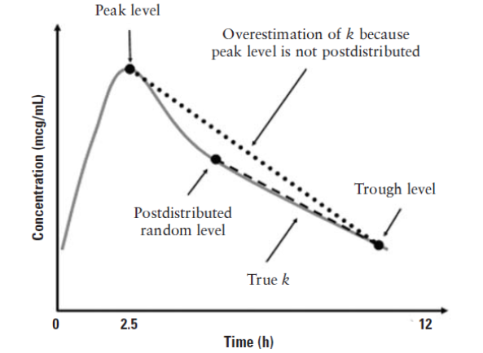
Therapeutic Drug Monitoring
EXAMPLE
UPDATE TEXT WITH YOUR INSTITUTION
In patients without AKI who have adequate urine output, obtain 2 vancomycin levels within the same dosing interval.
Level 1: post-distributive random level (at least 60 minutes after completion of infusion)
Level 2: trough level (30 minutes prior to next dose) after at least:
4th dose if q8h dosing
3rd dose if q12h dosing
2nd dose if q24-48h dosing
Consider checking levels earlier in patients with S. aureus bacteremia
*Levels should be obtained at least 4 hours apart

Slide 17
Assess Calculated AUC
EXAMPLE
UPDATE TEXT WITH YOUR INSTITUTION
Input dosing variables into the vancomycin dosing calculator
Goals: AUC 400-600 mcg*h/mL AND trough 9.5-20 mcg/mL
If current regimen is within goal ranges: continue current regimen
If AUC OR trough is outside the goal range: change vancomycin regimen to meet above criteria
Regardless of whether or not a dose change was made in Step 2, recheck AUC in 3-5 days
Repeat Step 2 and 3 until two consecutive therapeutic AUC and trough levels on the same regimen are achieved
Then, repeat levels weekly, at minimum, throughout duration of vancomycin therapy if no AKI and adequate urine output

Slide 18
Revised Trough Targets
Screenshot of institutional trough targets for various indications for patients receiving trough based dosing

Slide 19
Thank you for watching and listening to this presentation in its entirety
Click here to complete the acknowledgment form
Recommend prescribers linking this to some kind of form/tracker so you can reference back that they were trained

